Slide 1
Ubicomp and Smart Home/City
Maanya | Jack | Ish | Disha

Slide 2






Agenda
Hydro Sensing
Energy Sensing
Surface Sensing
Dynamically measuring water usage throughout the entire household utilizing pressure metrics
Pinpointing energy usage by appliance, enabling analysis and mitigation
Determining severity of deterioration of surfaces to save shocks, time, and lives
Combine these sensing capabilities (and more) to create happier, healthier, and more efficient homes and cities

Slide 3


HydroSense

Slide 4

Water Facts!
Nearly 97% of the world’s water is salty or otherwise undrinkable. Another 2% is locked in ice caps and glaciers. That leaves just 1% for all of humanity’s needs — all its agricultural, residential, manufacturing, community, and personal needs.
The average family can waste 180 gallons per week, or 9,400 gallons of water annually, from household leaks. That's equivalent to the amount of water needed to wash more than 300 loads of laundry.

Slide 5
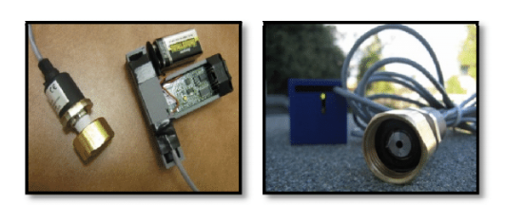
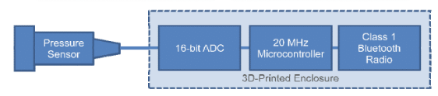
What is HydroSense?
HydroSense, a low-cost,single-point solution for activity sensing mediated by a home’s existing water infrastructure. HydroSense is based on continuous analysis of pressure within a home’s water infrastructure.
Consists of a customized stainless steel pressure sensor, an analog-to-digital converter (ADC) and microcontroller, and a Bluetooth wireless radio.

Slide 6
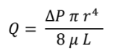
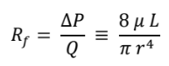
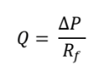
Calculation of water flow
Flow rate is related to pressure change via Poiseuille’s Law -
This can be simplified by the fluid resistance formulation -
The final formula then is -
Notes:
Flow rate is related to pressure change via Poiseuille’s Law,which states that the volumetric flow rate of fluid in a pipe Q is dependent on the radius of the pipe r, the length of the pipe L,the viscosity of the fluid μ and the pressure drop ΔP. This can be simplified by the fluid resistance formulation,which states that the resistance of flow is proportional to the drop in pressure divided by the volumetric flow rate

Slide 7
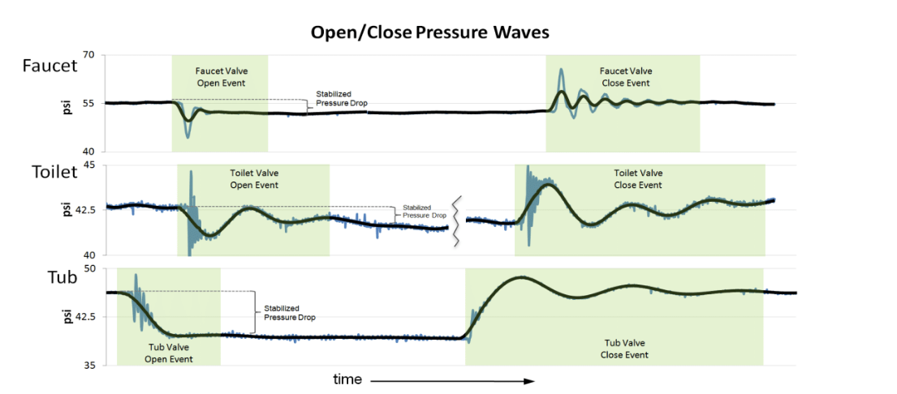

Slide 8
Potential issues with HydroSense
Events that occur at the exact same instant cannot be distinguished as separate events with the current segmentation algorithm.
The current sampling is done in a controlled manner
They do not account for the smoothness of the inner pipe surface, the number of bends, valves, or constrictions in pipes, nor pipe orientation.
Notes:
e.g., how often do people partially open valves vs.open them full stop, how is the signal affected by the speed of valve opening or closure

Slide 9
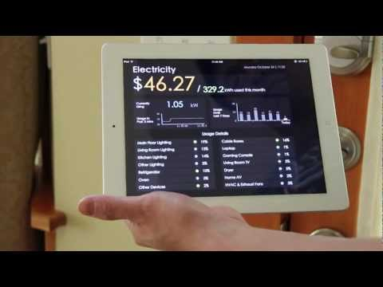

Slide 10

Discussion Questions
Is there any scope of using HydroSense by everybody in the world? Why or why not?
Are there any other potential issues related to the usage of HydroSense other than the ones mentioned earlier?
Other than measuring the water flow, is there anywhere else this technology can be used?

Slide 11
Electrisense | Single-Point Sensing | Electrical Event Detection & Classification
Sidhant Gupta | Matthew S. Reynolds | Shwetak N. Patel

Slide 12
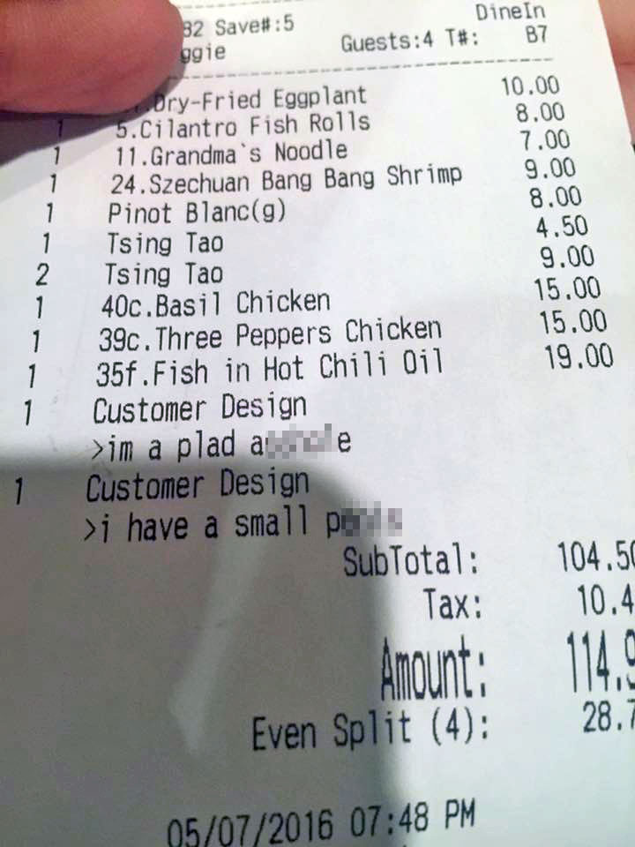
Notes:
Restaurant receipt always shows you why you are being charged for and exactly what?

Slide 13
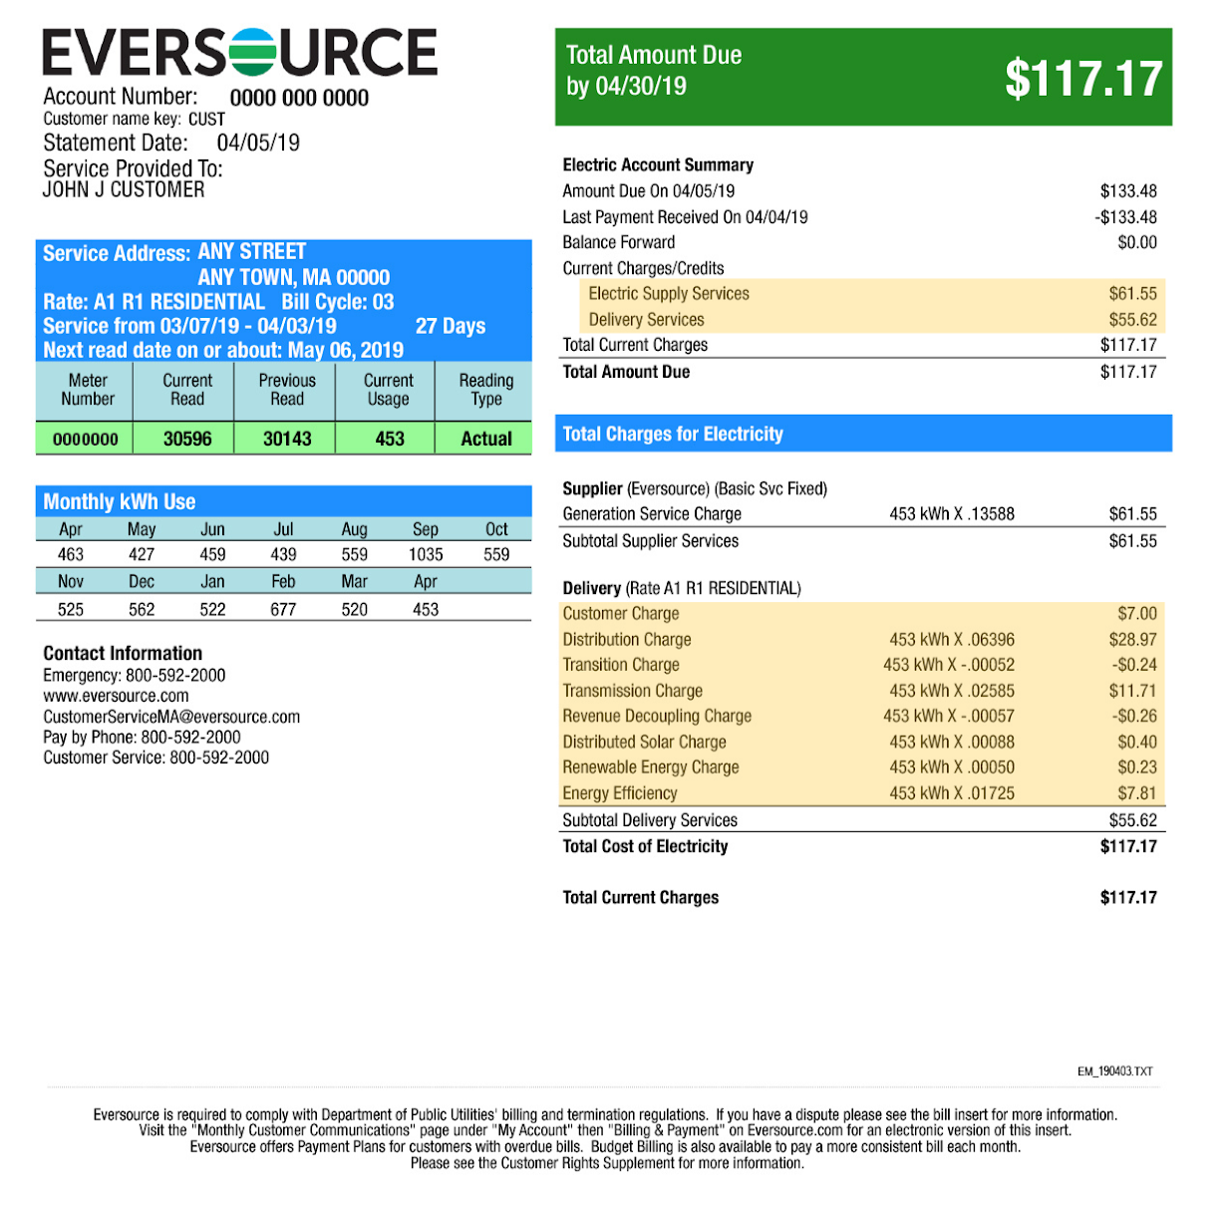
Notes:
Electricity bill is never detailed on how much each device in your house is consuming?

Slide 14


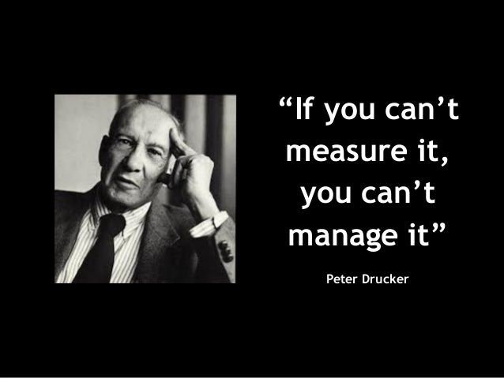
Notes:
Goes for anything: Unless you measure it, you cannot reduce it.

Slide 15
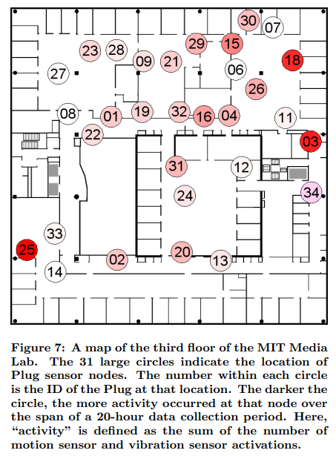
Distributed Sensing
Dedicated sensors for each appliance or area.
Problems: Costly installation and maintenance.
Potential Solution: reduce cost by using a single point to sense
Image Source: Lifton, J., Feldmeier, M., Ono, Y., Lewis, C., and Paradiso, J. A. A platform for ubiquitous sensor deployment in occupational and domestic environments
Notes:
Related work highlights about Distributed sensing from Lifton et al[14]

Slide 16
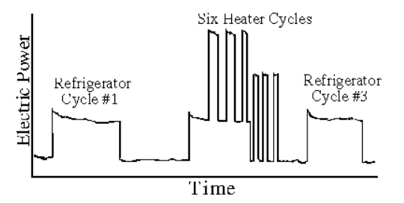
Single Point Sensing
Metering technique for whole-house appliance usage via power meter.
Problem: relies on step change activation to identify usage.
Potential Solution: utilize advancing chip technology and shifting macro trends (SMPS systems) to a get high accuracy, low cost solution
Fig: total (real) power consumption vs. time for a single-family home over a two-hour period
Image Source: http://www.georgehart.com/research/nalm.html
Notes:
NALM:Nonintrusive Appliance Load Monitor (NALM)
plots total (real) power consumption vs. time for a single-family home over a two-hour period. During this interval, the total load shows activity due to a refrigerator and a heater. Two different-sized step changes are clearly present, providing characteristic signatures of the refrigerator and the heater. The refrigerator cycles on and off three times, the heater six times. By measuring the total load ouside the home, it is not difficult to find these step changes and measure their size. Knowing the time of each on and off event, the total energy consumption of the refrigerator and the heater are easily determined

Slide 17
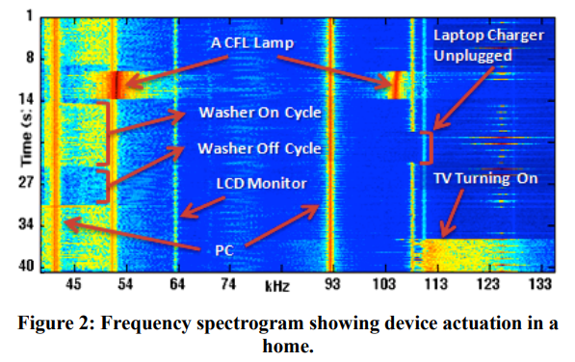
Electrisense (2010)
A single point system utilizing high frequency EMI signals from each SMPS appliance
SMPS do not dissipate power as heat, rather store energy in high frequency switches
Enables high efficiency, and to our benefit, distinct signals to monitor
Image Source: Reading 1, Electrisense paper
SMPS additional read: https://www.techopedia.com/definition/12378/switched-mode-power-supply-smps
Notes:
Figure 2 shows a frequency domain waterfall plot showing appliances being turned on and off. As is evident from the graph, when the device is turned on we see a narrowband continuous noise signature that lasts for the duration of the device’s operation. Also note that the noise center is strongest in intensity and then extends to lower and higher frequencies with decaying intensity, which can loosely be modeled with a Gaussian function having its mean at the switching frequency.
Switched Mode Power Supply(SMPS): https://www.techopedia.com/definition/12378/switched-mode-power-supply-smps : converts power (eg AC to DC) by switching on and off the devices in it at very high frequencies.
SMPS advantages:
Makes the device high in efficiency
Tracks individual source levels (where the device is plugged in) i.e. works irrespective of device plug in location
Robust to simultaneous device activation
You can also distinguish with some error between device of same brand and model
Why SMPS?
ElectriSense relies on the fact that most modern consumer electronics and fluorescent lighting employ switch mode power supplies (SMPS) to achieve high efficiency. These power supplies continuously generate high frequency electromagnetic interference (EMI) during operation that propagates throughout a home’s power wiring. We show both analytically and by in-home experimentation that EMI signals are stable and predictable based on the device’s switching frequency characteristics. Unlike past transient noise-based solutions, this new approach provides the ability for EMI signatures to be applicable across homes while still being able to differentiate between similar devices in a home.

Slide 18
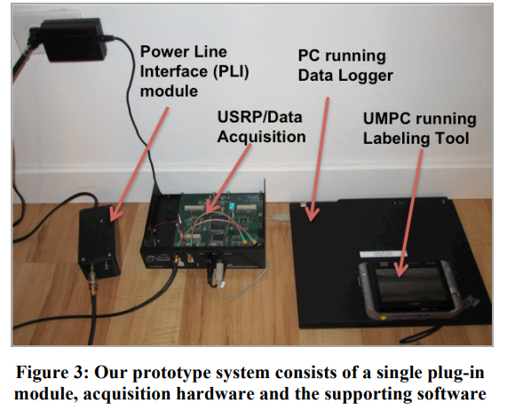
The Experiment
The Setup
7 homes, 6 short term (H1-H6), 1 six month deployment (H7)
In home devices + 8 20’’ dell monitors, a camera charger and 2 CFL lamps.
Once configured, just plug into an outlet! So much easier than other systems
Notes:
Our prototype system consists of a single custom Power Line Interface (PLI) plug-in module that can be plugged into any ordinary electrical outlet in the home (Figure 3). The output of the plug-in module is connected to a high speed data acquisition system based on the Universal Software Radio Peripheral (USRP) that digitizes the analog signal from the plug-in module and streams it over a USB connection to a data collection and analysis PC running GNU Radio, which in real-time samples and conditions the incoming signal. The ElectriSense algorithms then watch for an event and extract features that are used to identify and classify the device causing the event.
To capture and analyze the electrical noise on the power line, we built a custom power line interface (PLI) module for our analog frontend. It is necessary for this module to filter out the AC line frequency (60 Hz in the U.S.) so that the spectrum analyzer or any analog-to-digital device is not overloaded by the strong 60Hz frequency component.
The filtered signal is then fed into the USRP, which acts as a general purpose analog to digital converter sampling at a rate of 1 MHz set through the software. The digitized signal is streamed from the USRP to our processing software over USB.
The incoming time domain signal stream from the USRP is buffered as 2048-point vectors and FFTs of these are computed to obtain the frequency domain signal.

Slide 19
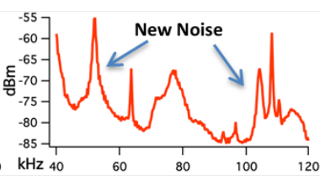
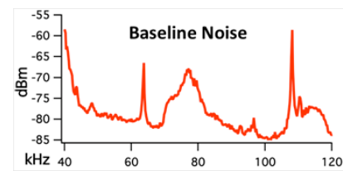
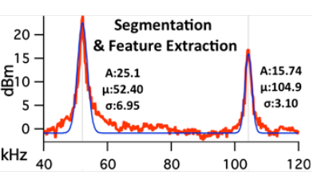
—
=
25?
Amplitude, Mean and Variance captured
Notes:
Sliding window average with a window size of 25.
Window Size: Using a window that is too small results in an increase in the false positives whereas a large window size increases the shortest duration between near simultaneous events that is needed for the system to detect them as separate events.
When the system first starts, it computes an average of 25 frequency vectors and stores it as the baseline noise signature in the power line. Thereafter, a new window is calculated every 25 frequency vectors, and a difference vector with the baseline noise signature is computed. When a device is actuated and new noise in the frequency domain is introduced to the power line, the difference vector reflects this change, thus segmenting the event
Our feature extraction algorithm finds peaks above the threshold using the difference vector and fits a Gaussian function to extract the mean, amplitude and variance parameters
SMPS devices will generate noise frequencies.

Slide 20

Device classification using
K Nearest Neighbours

Slide 21
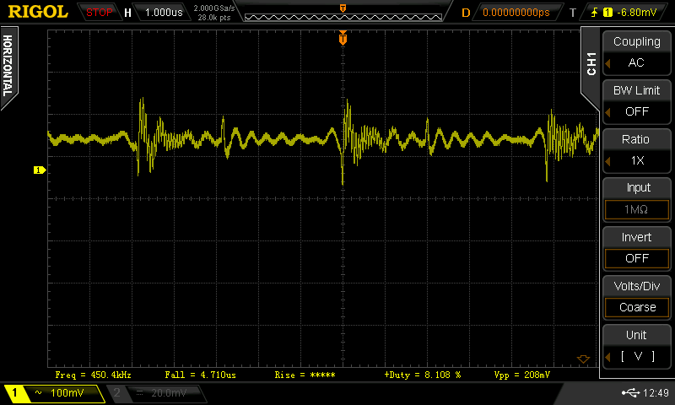
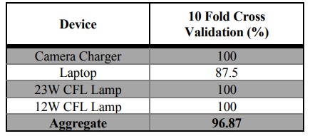
Issue with windowing
Notes:
We found that the laptop’s power adaptor was harder to identify because the extracted feature vector for this device in H6 looked slightly different than the other homes. Upon closer inspection, the noise generated by the laptop’s adaptor had a harmonic peak that was very close in amplitude to the center frequency. This marginal difference caused the peak detection algorithm to assign the first harmonic as the center frequency in H6, thus extracting a different feature vector.
A simple approach to alleviate this problem is by employing an algorithm that classifies an event only if the distance between the event feature vector and the nearest neighbor in KNN is less than a certain threshold. If not so, the algorithm builds a new feature vector from the next strongest peak. Using this new method, classification accuracy for the laptop was 100%.

Slide 22
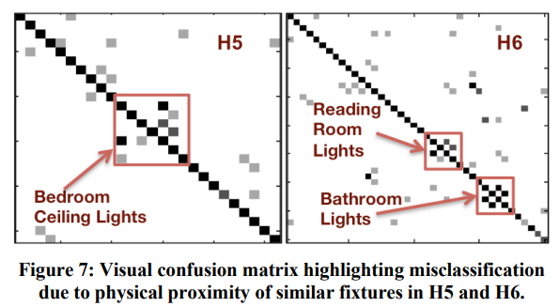
Issue with same brand, same device model
Notes:
Classifier correctly identified similar light fixtures (i.e, the same model and brand) that were located in different rooms.
However, H5 and H6 had rooms where the same models of fluorescent light fixtures were installed spatially near each other (1-2 feet apart), which produced very similar noise signatures. Thus, these particular lights did not have sufficient differences nor were they far apart enough along the power line to differentiate between those lights
Alleviate this by labelling such things as one event.

Slide 23

What’s not right?
Did you find more limitations to this 2010 work?
KNN can not work if we give some new devices to the system as we only have data for some specific devices.
Needs user to actuate each device atleast once. So it is not a device detection system per se until all devices are used.
The EMI in SMPS is considered to be a disadvantage in these power supplied. Relying on a disadvantage for creating technology can make this obsolete.

Slide 24
Were there some interesting things you learnt while reading this
work ? Was there anything you found unique about this paper different from other papers we have read so far? Data collection? Performance calculation?
What in your opinion got this paper the best paper award? What have the authors done so well?
How is this work - Electrical device detection relevant to us or to Ubiquitous Computing for Smart Home/Smart City? How and where can we leverage it? Any project ideas you can suggest to the class?
Notes:
Interesting things: Long term deployment, they asked people to label the data and they created a queue whenever an event was detected and if the people did not label it for a particular time, it got purged from the queue.
Went from house to house(kept apparatus on a cart) than stay at one place(1 department ) like in other papers.

Slide 25
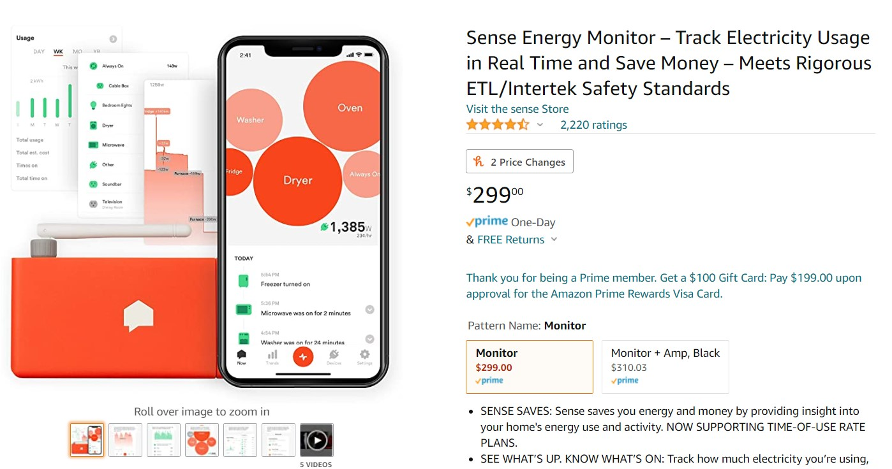
UbiComp Applications ready for use
Notes:
https://blog.sense.com/articles/how-does-sense-detect-my-devices/

Slide 26
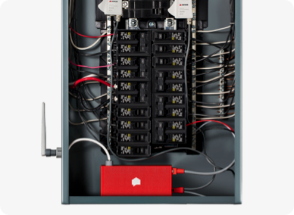
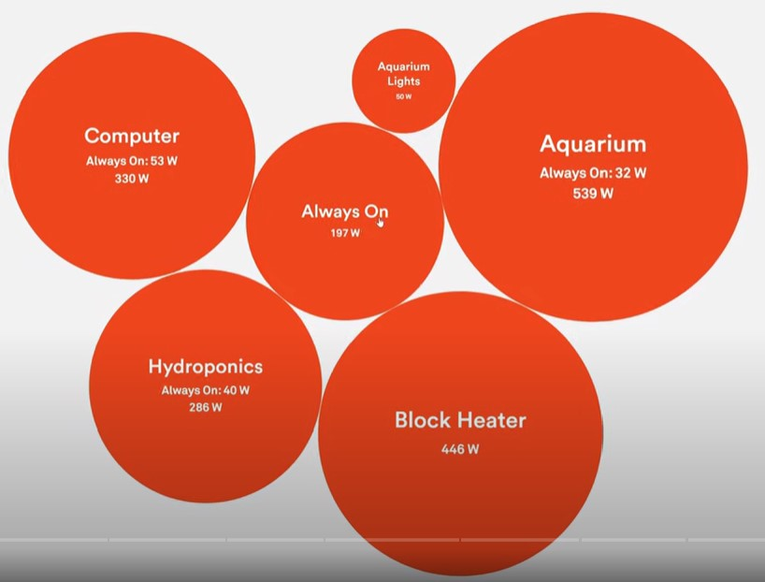
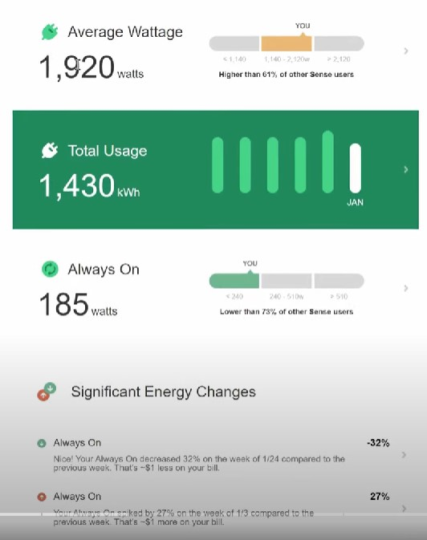
Notes:
Detects devices and the power it is using based on the signal signature of each device in the power line.
Shows accurate electric cost, so if one bulb costs more, change it to the other bulb
If you connect solar power panels and detect how much energy is being generated

Slide 27
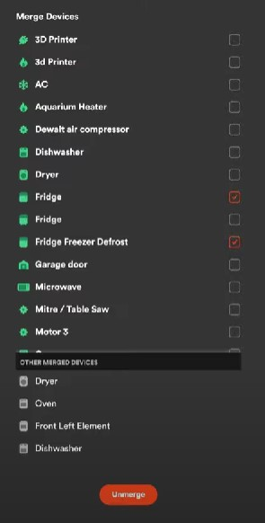
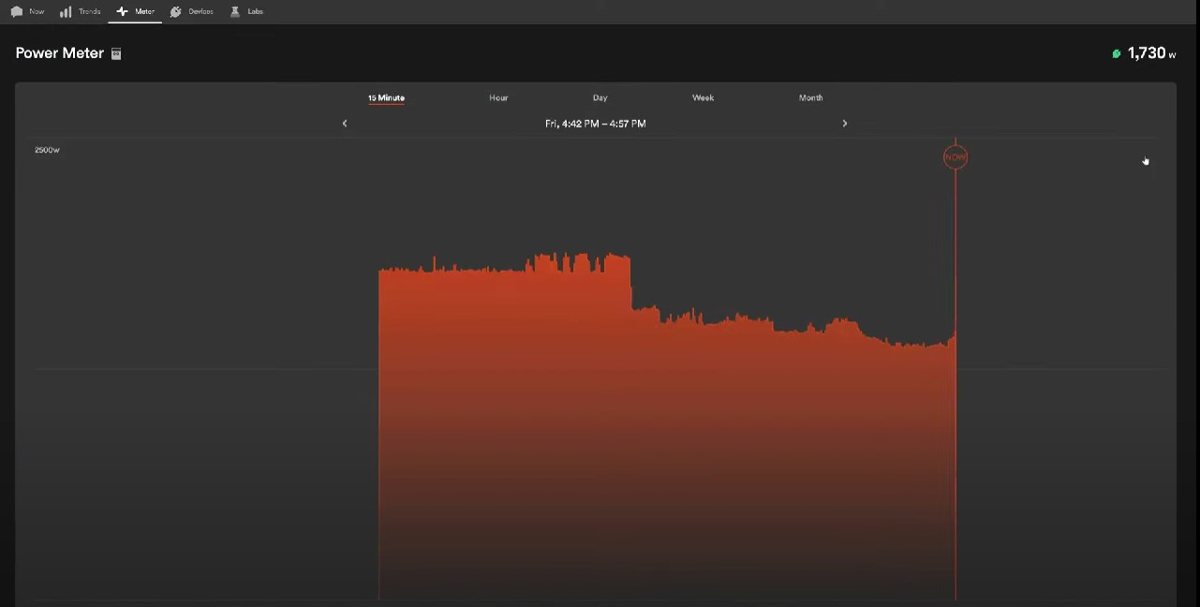
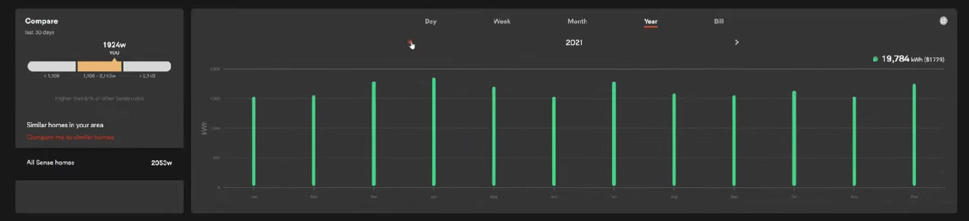
Notes:
You can see custom notifications for a device : ring fire alarm/connect alexa with it to announce relevant message in the house if the stove takes more than required power or is on during night hours
See live consumption
A user found a faulty unplugged extension cord using 80W in power doing nothing
A faulty microwave on stand by using/not using power | Left straightener plugged in on?
Futuristic Use: Connect to habit management apps: more laptop, more TV etc.

Slide 28
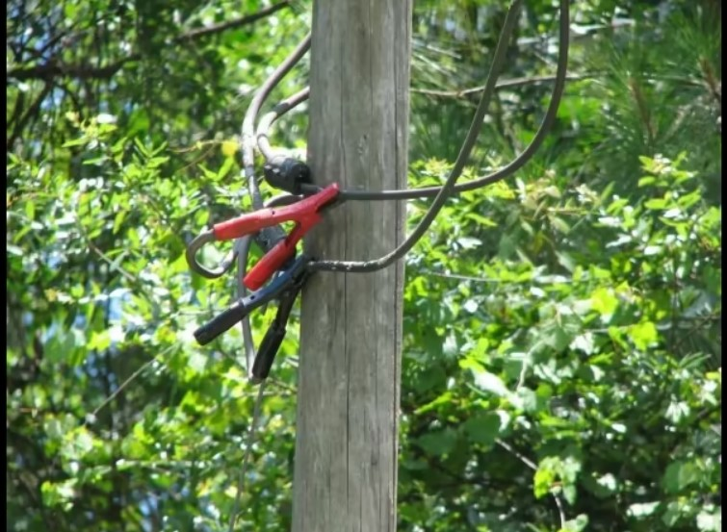
Notes:
Electricity theft alleviation: You can now see if the bills you’re paying are only your own!

Slide 29
Pothole Patrol
Municipalities around the world spend millions of dollars, yet few people are happy with quality of the roads.
Bad roads
Damage vehicles
Hazardous to drivers and pedestrians
Very annoying to drive or bike on
The researchers are trying to find out potholes on travelled roads using different sensors in vehicles so that those that are of high severity could be repaired.
“Runs on a network of 7 taxis in the Boston metropolitan area”

Slide 30
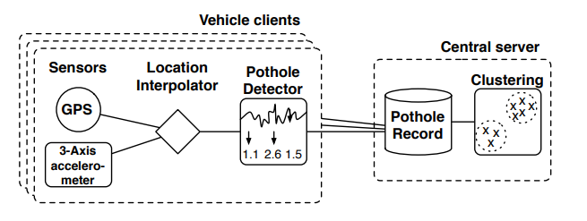
P2 architecture
Notes:
On-board processing filters the combined data stream to produce high-probability pothole detections. When network connectivity is available, the cars automatically upload their detections to a central server, which clusters detections based on location, and applies a minimum cluster size, resulting in the final output of the system.

Slide 31
Challenges
Gathering data is challenging because this would require driving through bad roads. Also, gathering hand-labeled training data would require a lot of effort.
Used loosely labeled data as well because completely labeled data is harder to collect.
Normal events such as fast brakes, speeding, etc. might look similar to some sensors.
Different filters are used to resolve this issue (to be continued)

Slide 32
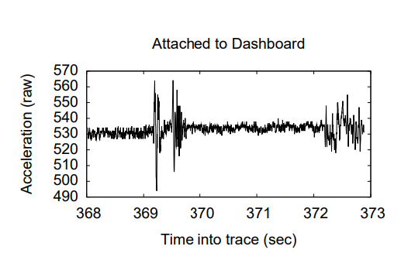
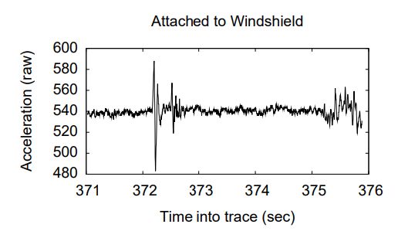
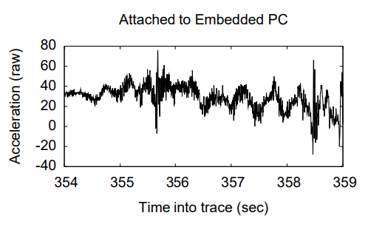
Accelerometer Placement
Notes:
Finalized to dashboard inside the car’s glove box because it was easier to install than windshield.

Slide 33
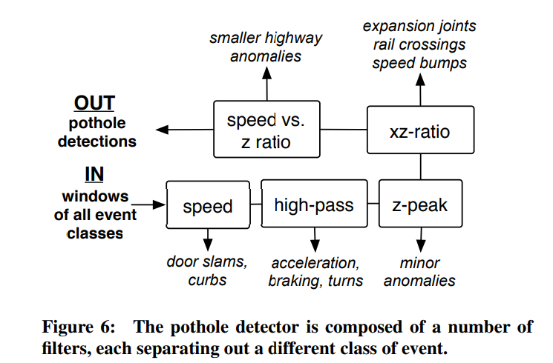
Different Filters
Notes:
Data is first segmented into 256-sample windows.
Speed - Uses a “speed threshold”. `Windows in which car is not moving, or is moving slowly, are ignored. This rejects events such as door slams, as well as most curb ramps.
High-pass - The high-pass filter removes low-frequency components from the acceleration signal in all the x- and z- axes. Such components can be introduced by acceleration, turning, veering, braking, and as well as subtle changes in sensor orientation.
Z-peak - Peak acceleration in the z-axis is a prime characteristic of significant road anomalies. This rejects all windows with a peak (absolute) z-acceleration less than a threshold T_z.
XZ-ratio - Rejects windows where peak-acceleration is les than some factor t_s times the peak z-acceleration.
Speed vs. z ratio - At high speeds, even small road anomalies can create high peak acceleration reading. Rejects where the peak z acceleration is less than a factor t_s times the speed of travel.

Slide 34
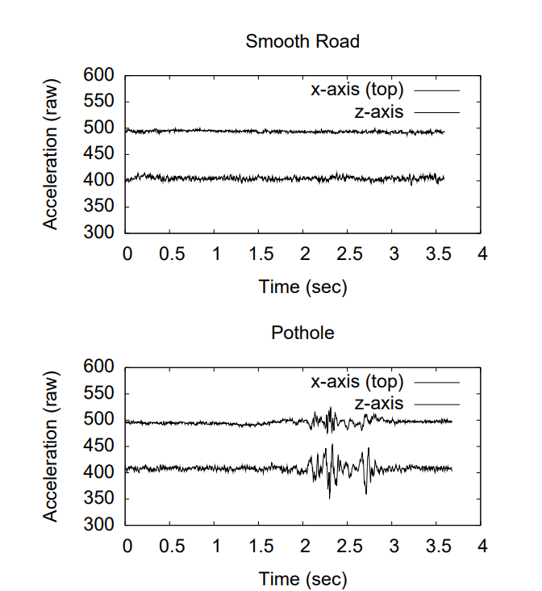
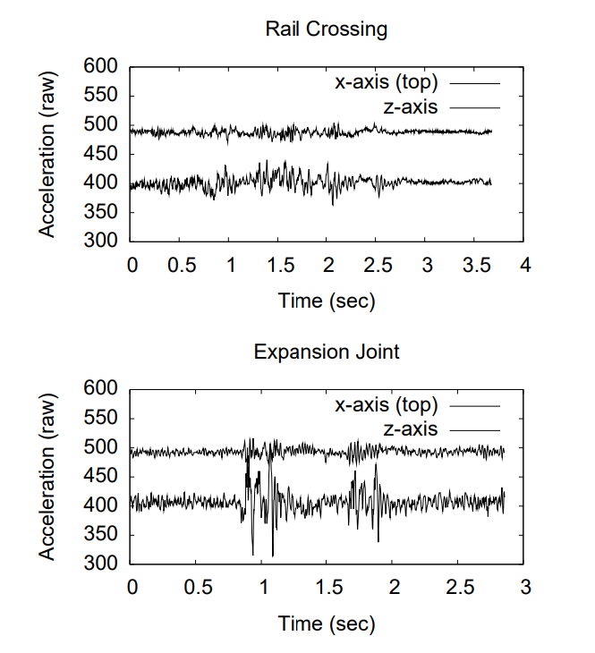

Slide 35
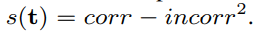
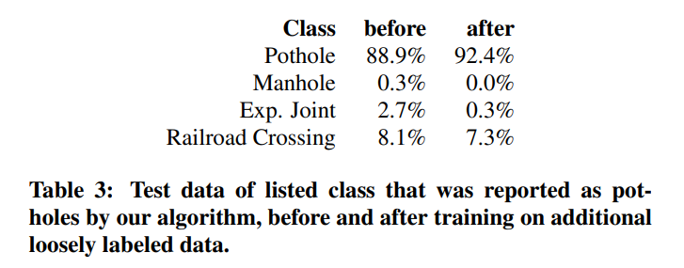
Training
Notes:
Emphasizes on minimizing false positives

Slide 36
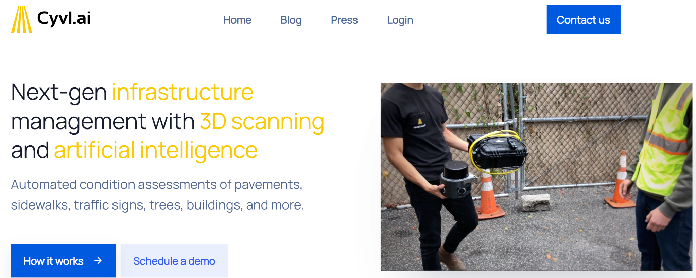
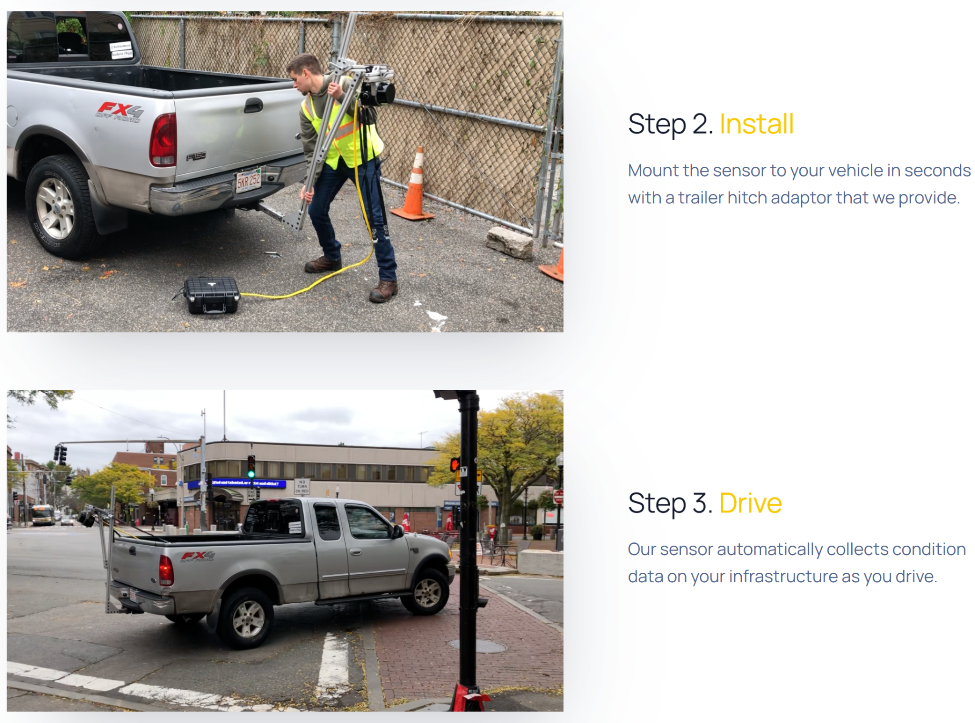

Slide 37
Discussion questions
In the P2 architecture, the predictions are processed on car. Could that be limiting the predictions because complex models can’t be processed on car?
Could the research be applicable to wide scale such that every car is reporting potholes? Are there any issues that would need to be fixed to make before making it widespread?
GPS doesn’t give the most precise localization information. Since the sensors are inside a vehicle which is mostly outdoors and most cabs have internet access, could that be used to get a better prediction?
Notes:
Soekris 4801 embedded computer running Linux, a WiFi card, a Sprint EVDO Rev A network card, an external GPS (mounted on the roof of the car), and a 3-axis accelerometer (mounted in the same place and with the same orientation in each car)
Soekris 4801 - 233 or 266 Mhz clock

Slide 38
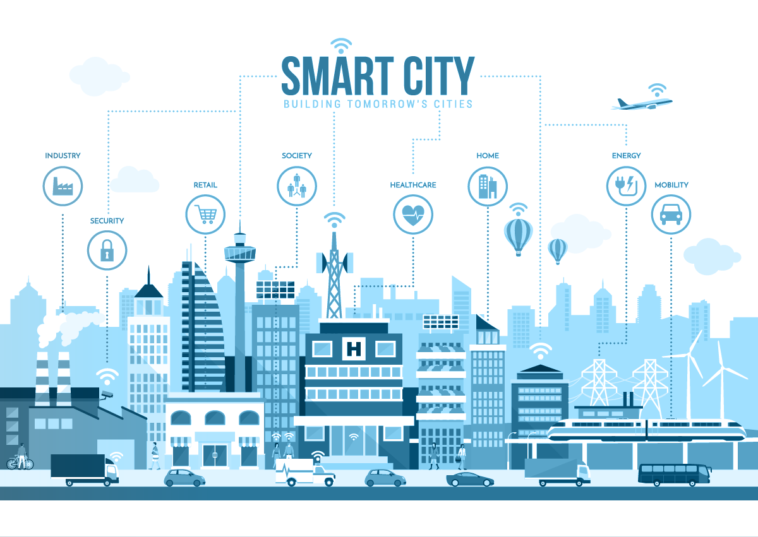

Slide 39
Closing thoughts
What synergies can we identify between these 3 sensing technologies?
What additional technologies or sensors could be implemented into this system?

